Slide 1

John Lewis Invictus Academy FY24 Budget Approval Meeting
Ramon Garner, Principal
March 13, 2023

Slide 2
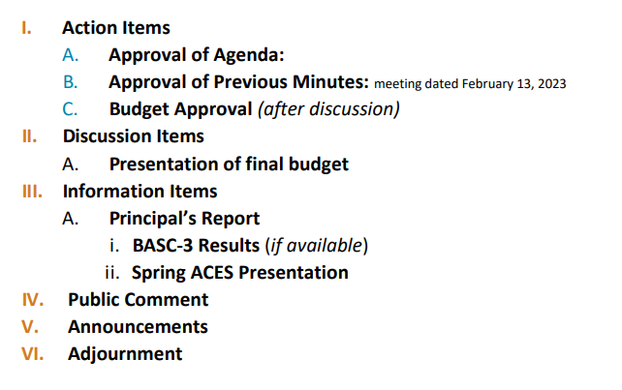
Agenda

Slide 3
Norms
This is a meeting of the GO Team. Only members of the team may participate in the discussion. Any members of the public present are here to quietly observe.
We will follow the agenda as noticed to the public and stay on task.
We invite and welcome contributions of every member and listen to each other.
We will respect all ideas and assume good intentions.

Slide 4

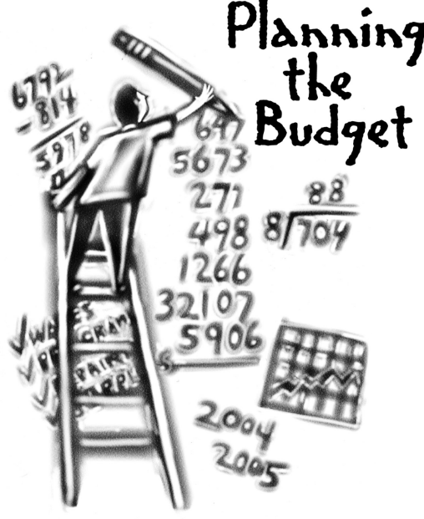
Overview of FY ‘24 GO Team Budget Process
Step 1 Review and Update Strategic Plan and Rank Strategic Priorities
By end of Fall Semester
Step 6 Principals: HR Staffing Conferences Begin
Late February – Early March
Step 3 GO Team Initial Budget Session: Allocation
January 31
January 24 – early February
Step 7 GO Team Final Budget Approval Meeting
March 14
Budgets Approved by March 17
Step 5
GO Team Feedback Session: Draft Budget Presented & Discussed
February 13
February – multiple meetings, if necessary
Step 4 Principals: Associate Supt. Discussions and Review
February (supports needed, specific challenges, coaching)
Step 2 Principals: Workshop FY 24 Budget
January 24, 2023
GO Teams are encouraged to have ongoing conversations about the school’s budget.

Slide 5
Budget Approval Meeting
What
During this meeting GO Teams will review the budget, which should be updated based on feedback from the staffing conference, Associate Superintendents, and key leaders. After review, GO Teams will need to take action (i.e., vote) on the FY24 Budget.
Why
Principals will present the final budget recommendations for GO Team approval.
When
All approval meetings must be held after staffing conferences. Budgets must be approved by March 17th.

Slide 6
Budget Review

Slide 7

FY24 Budget Parameters
FY24 School Priorities | Rationale
Improve students’ mastery of core content knowledge (ELA, Math, Science and Social Studies) | A majority of scholars arrive at JLIA reading below grade level & with gaps in both their literacy and math proficiency.
Close the student achievement gap with General Education Students and Students with Disabilities | “Lagging achievement evidenced as early as fourth grade appears to be a powerful predictor of rates of high school and college graduation, as well as lifetime earnings” (McKinsey and Company, The Economic Impact of the Achievement Gap in America’s Schools, 2009).
Implement STEAM enriched curriculum to drive interdisciplinary and project-based teaching and learning approaches. | Atlanta is bustling with economic opportunities and a growing job market. We aspire for our students to have the type of educational experiences and success at JLIA that will position them not only to graduate high school, but to go onto college and emerge with the qualifications needed to land the types of high-paying jobs that will be waiting for them in their community.
Prepare all students to have the essential life skills to be self-aware, collaborative, and accepting diversity. | A majority of JLIA scholars are impacted by the social, emotional, behavioral, & health determinants of poverty that keep them from thriving academically in school.
Notes:
Review the priorities that the GO Team has developed and the rationale for these priorities. Feel free to copy this slide if you have more than 3 priorities to account for.

Slide 8
FY24 Budget Parameters
FY24 School Priorities | Rationale
Prepare and develop knowledgeable staff focused on quality teaching. | JLIA teachers need PD, coaching, and collaborative planning (PLC) support to equip them with the knowledge, skills, and mindsets necessary to ensure that every student has access to grade-appropriate assignments, strong instruction, deep engagement, and teachers with high expectations, every day, in every class—regardless of their race, ethnicity, or any other part of their identity.
Build teacher capacity in core content areas (ELA, Math, Science and Social Studies). | JLIA teachers need PD, coaching, and collaborative planning (PLC) support to equip them with the knowledge, skills, and mindsets necessary to ensure that every student has access to grade-appropriate assignments, strong instruction, deep engagement, and teachers with high expectations, every day, in every class—regardless of their race, ethnicity, or any other part of their identity.
Recommend high-quality staff for vacant positions. | JLIA teachers need PD, coaching, and collaborative planning (PLC) support to equip them with the knowledge, skills, and mindsets necessary to ensure that every student has access to grade-appropriate assignments, strong instruction, deep engagement, and teachers with high expectations, every day, in every class—regardless of their race, ethnicity, or any other part of their identity.
Notes:
Review the priorities that the GO Team has developed and the rationale for these priorities.

Slide 9
FY24 Budget Parameters
FY24 School Priorities | Rationale
Create a culture of high expectation for academic scholarship, civic responsibility and service for students, staff, and families. | In the classroom, we not only strive to close gaps, but to create a learning environment where students are positioned to thrive academically through daily exposure to rigorous and relevant content with practical, real-world applications.
Ensure systems and resources are aligned to school priorities. | In the classroom, we not only strive to close gaps, but to create a learning environment where students are positioned to thrive academically through daily exposure to rigorous and relevant content with practical, real-world applications.
Build systems and resources to support STEAM implementation. | In the classroom, we not only strive to close gaps, but to create a learning environment where students are positioned to thrive academically through daily exposure to rigorous and relevant content with practical, real-world applications.
Notes:
Review the priorities that the GO Team has developed and the rationale for these priorities.

Slide 10

Staffing Conference Changes
There were not any changes made to the draft budget we discussed at our last meeting.
As a quick summary, we will review the Budget by Function on the next slides.

Slide 11
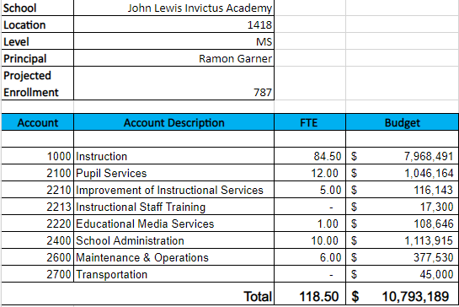
Budget by Function
*Based on Current Allocation of School Budget
Notes:
I am passing out the definitions for these funding categories. You will see what makes up each category. Although the school’s total budget amount will not change, allocation per function may change depending on our conversations and school needs.

Slide 12
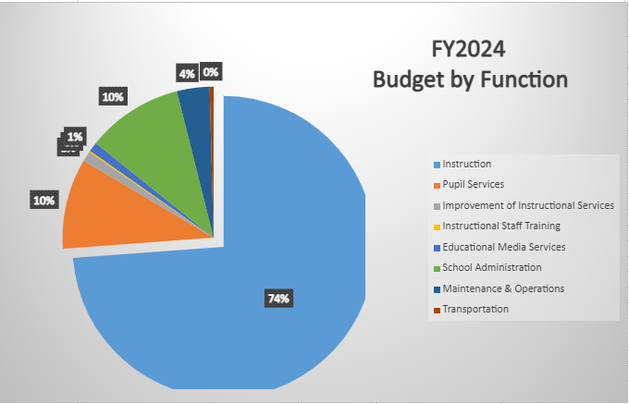
Budget by Function
*Based on Current Allocation of School Budget
Notes:
Explain the pie chart and allocations

Slide 13

Questions?

Slide 14
The GO Team needs to TAKE ACTION (vote) on the presented budget. After the motion and a second, the GO Team may have additional discussion. Once discussion is concluded, the GO Team will vote.
Action on the Budget

Slide 15

BASC-3 Data

Slide 16
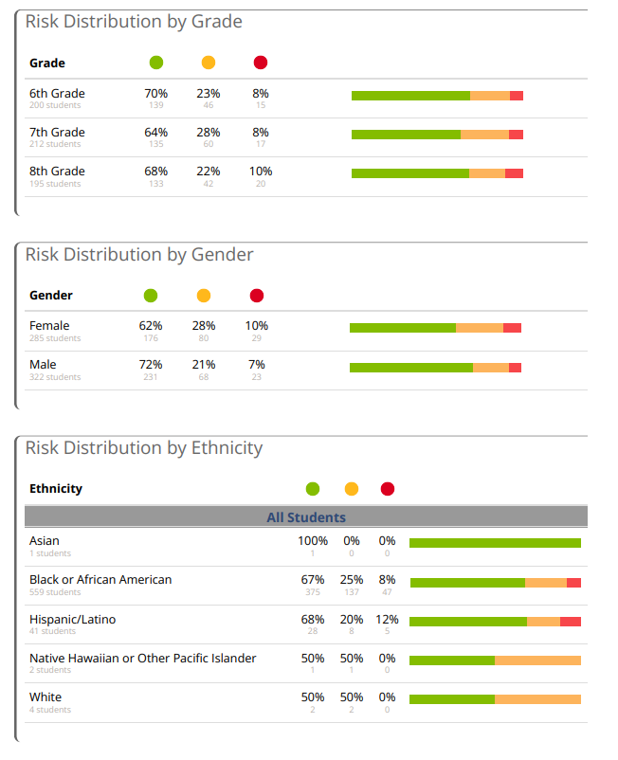
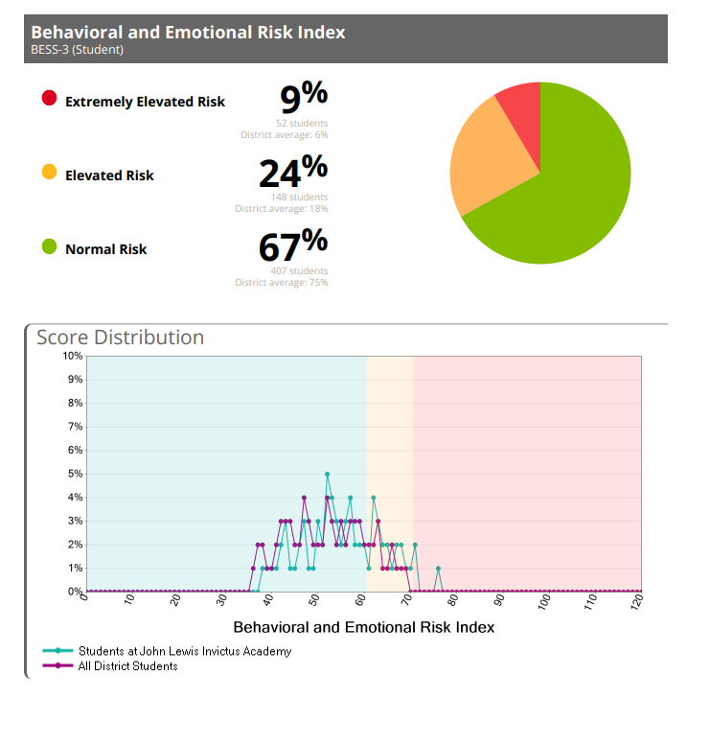

Slide 17

2023 Spring ACES
2023 Spring ACES Link
Accountability
Collaboration
Equity
Support

Slide 18
Questions?

Slide 19
Agenda

Slide 20

Thank you

